Slide 1

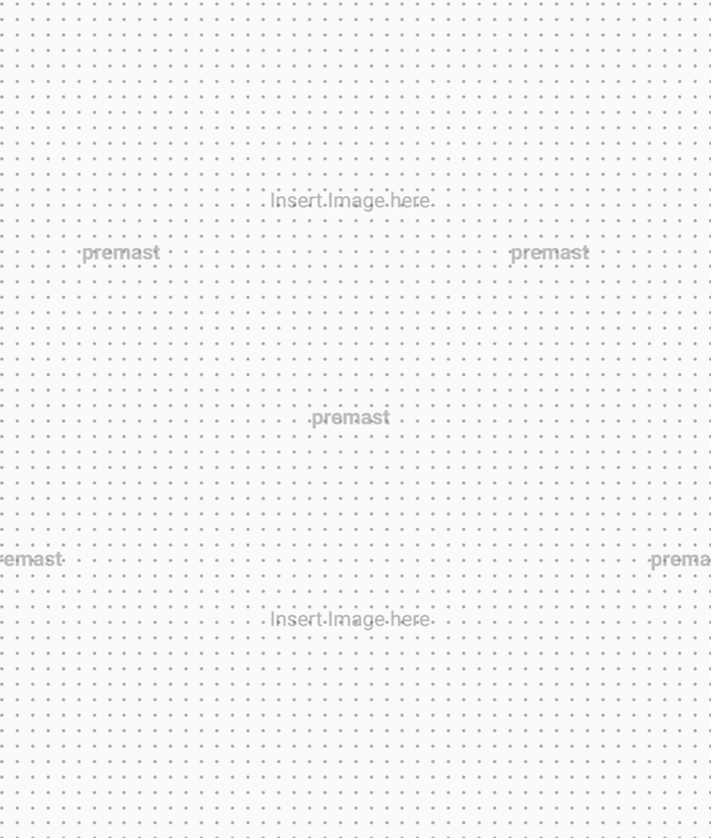

SITE
PROPOSAL
Custom marketing platform for Monica Dhilion
15 / 07 / 2026

Slide 2
WELCOME
This proposal covers the one-time build-out of Monica Site and the ongoing monthly care plan. You get a branded public site, a private portal for leads and UTM analytics, email + SMS + postcard campaigns with consent/opt-out, and Facebook / Instagram / LinkedIn scheduling — deployed on our existing fleet with near-zero extra infra.
15 / 07 / 2026

Slide 3
Website Build and Hosting with AI ML Operations
01
Bespoke custom site
05
Social Media Integration
Facebook, Instagram, LinkedIn
02
Optimized SEO
06
Physical Mail Integration
- Tested via Lighthouse
Create and manage from one location
03
07
Multi-Instance Redundancy
Timeline
- 4 weeks
04
08
Custom Domain Management
Investment summary
$2,240 build + $228.33/mo maintenance
15 / 07 / 2026

Slide 4
UX MOCKUPS
Click-through mockups of the public site and realtor portal — what the build-out delivers. Screenshots from proposal/pages.
15 / 07 / 2026

Slide 5
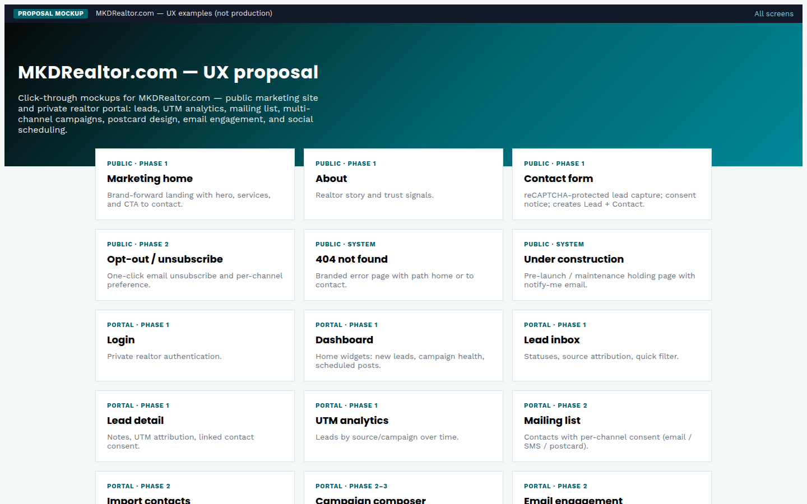
OVERVIEW
UX mockup
UX gallery hub
MKDRealtor.com · index.html · 15 / 07 / 2026

Slide 6
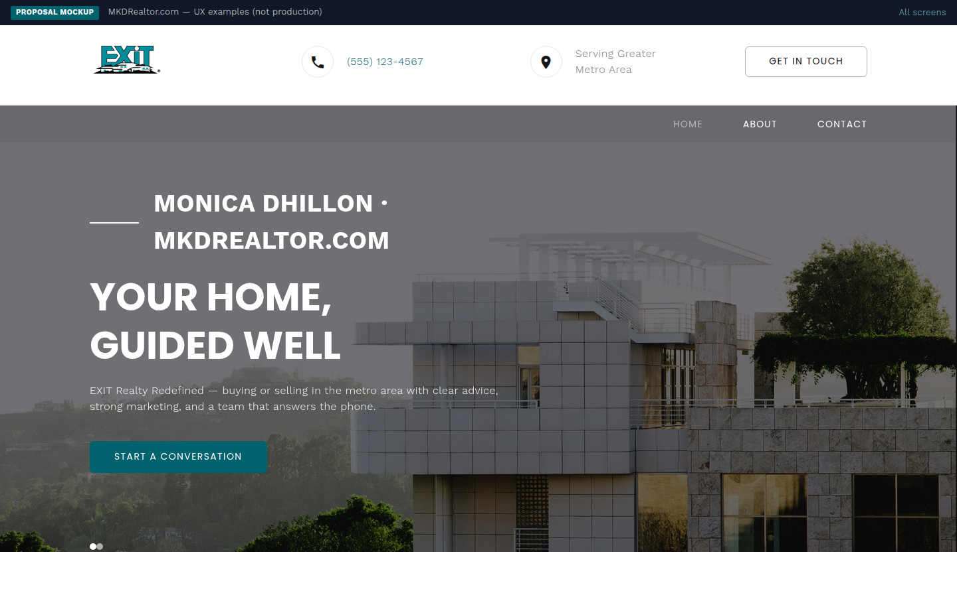
PUBLIC · PHASE 1
UX mockup
Marketing home
MKDRealtor.com · public-home.html · 15 / 07 / 2026

Slide 7
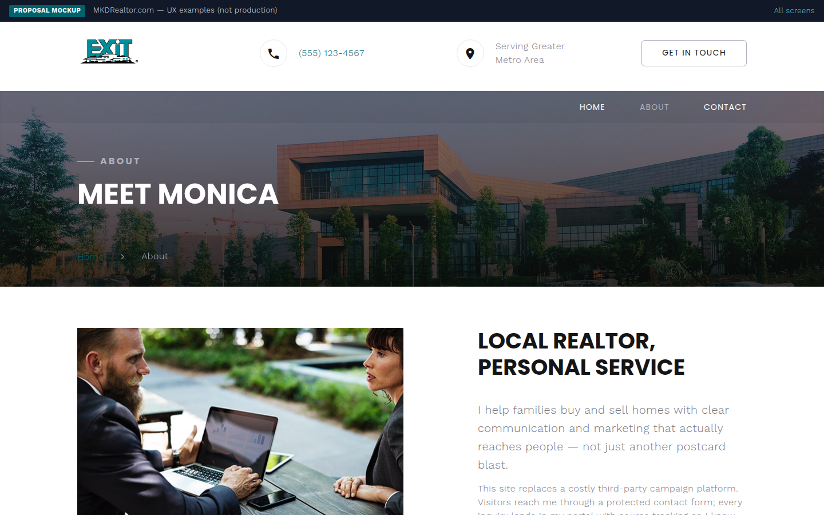
PUBLIC · PHASE 1
UX mockup
About
MKDRealtor.com · public-about.html · 15 / 07 / 2026

Slide 8
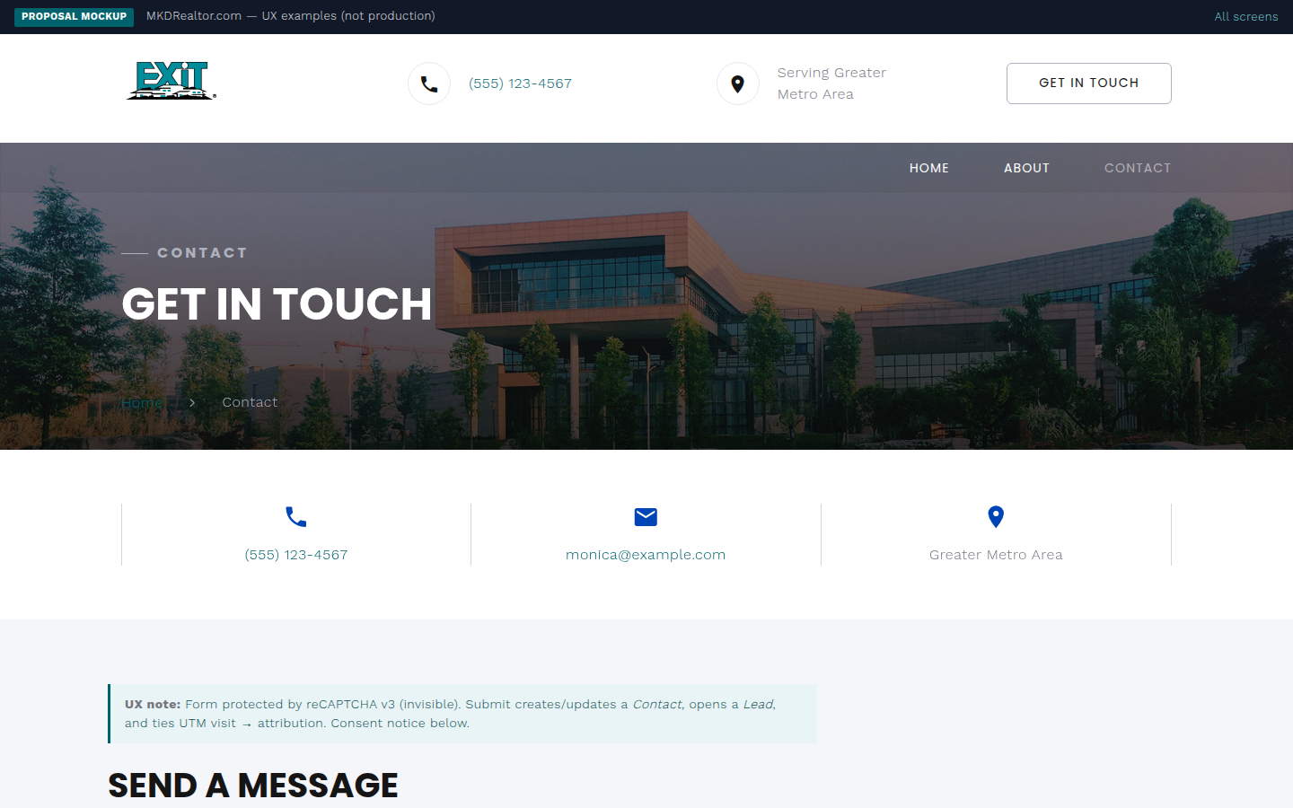
PUBLIC · PHASE 1
UX mockup
Contact form
MKDRealtor.com · public-contact.html · 15 / 07 / 2026

Slide 9
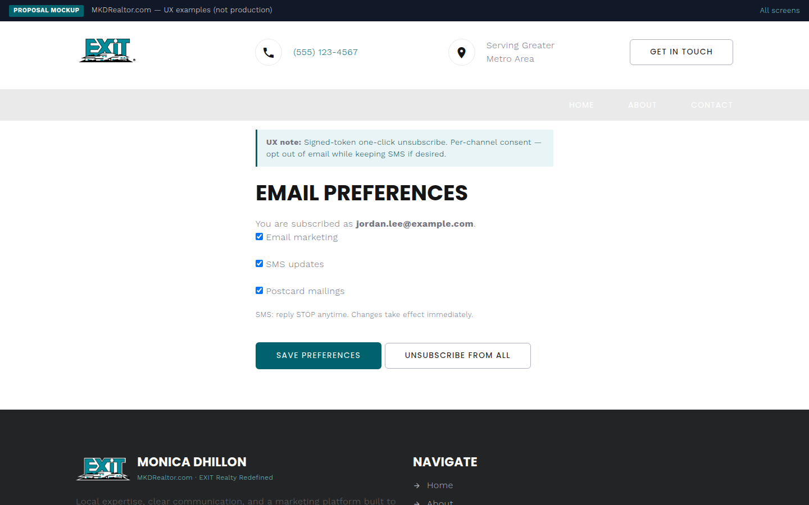
PUBLIC · PHASE 2
UX mockup
Opt-out / unsubscribe
MKDRealtor.com · public-unsubscribe.html · 15 / 07 / 2026

Slide 10
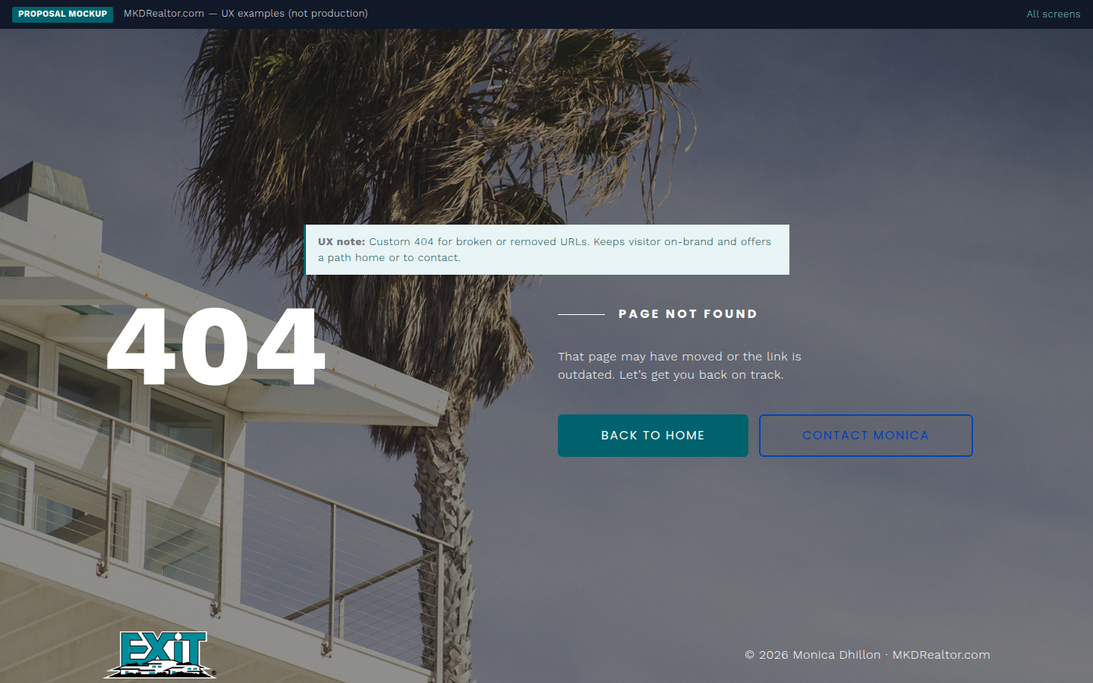
PUBLIC · SYSTEM
UX mockup
404 not found
MKDRealtor.com · public-404.html · 15 / 07 / 2026

Slide 11
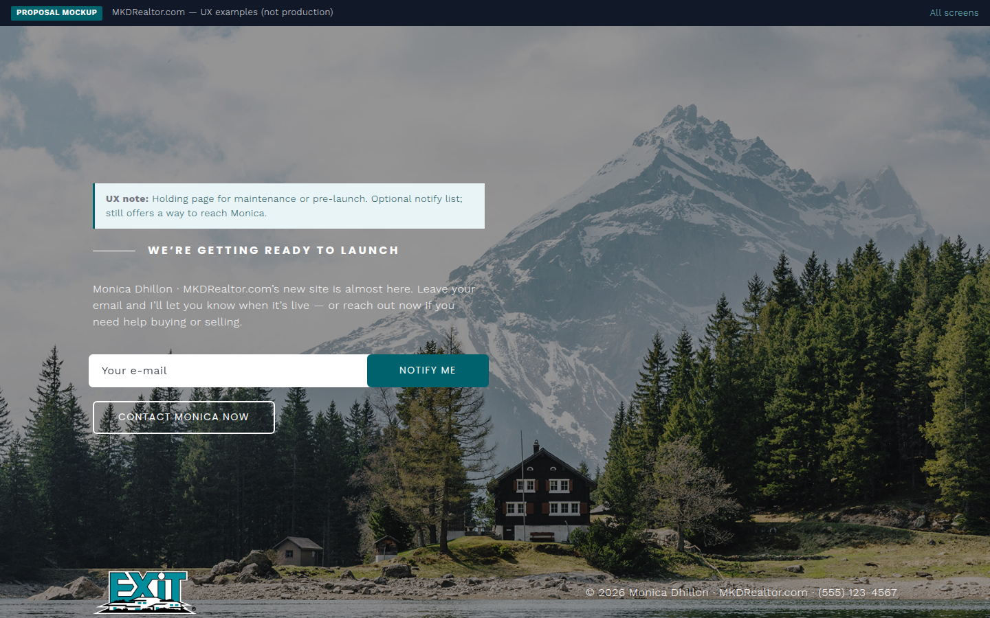
PUBLIC · SYSTEM
UX mockup
Under construction
MKDRealtor.com · public-under-construction.html · 15 / 07 / 2026

Slide 12
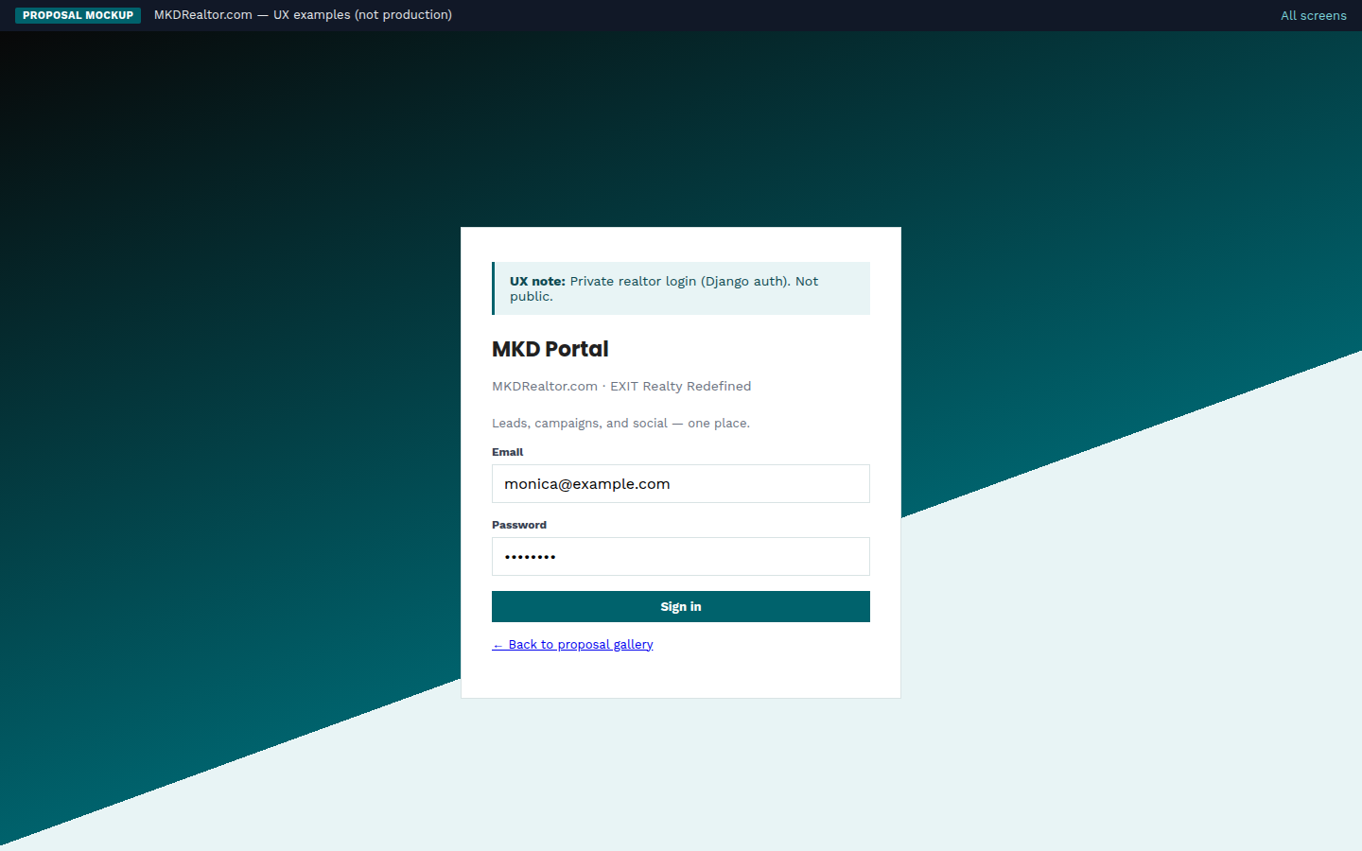
PORTAL · PHASE 1
UX mockup
Portal login
MKDRealtor.com · portal-login.html · 15 / 07 / 2026

Slide 13
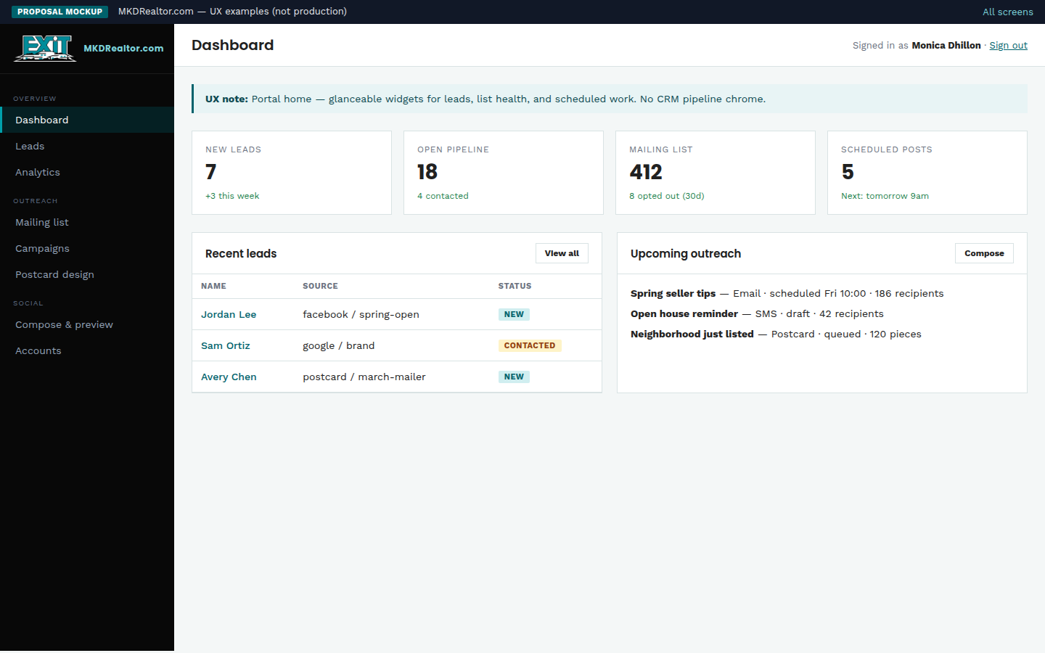
PORTAL · PHASE 1
UX mockup
Dashboard
MKDRealtor.com · portal-dashboard.html · 15 / 07 / 2026

Slide 14
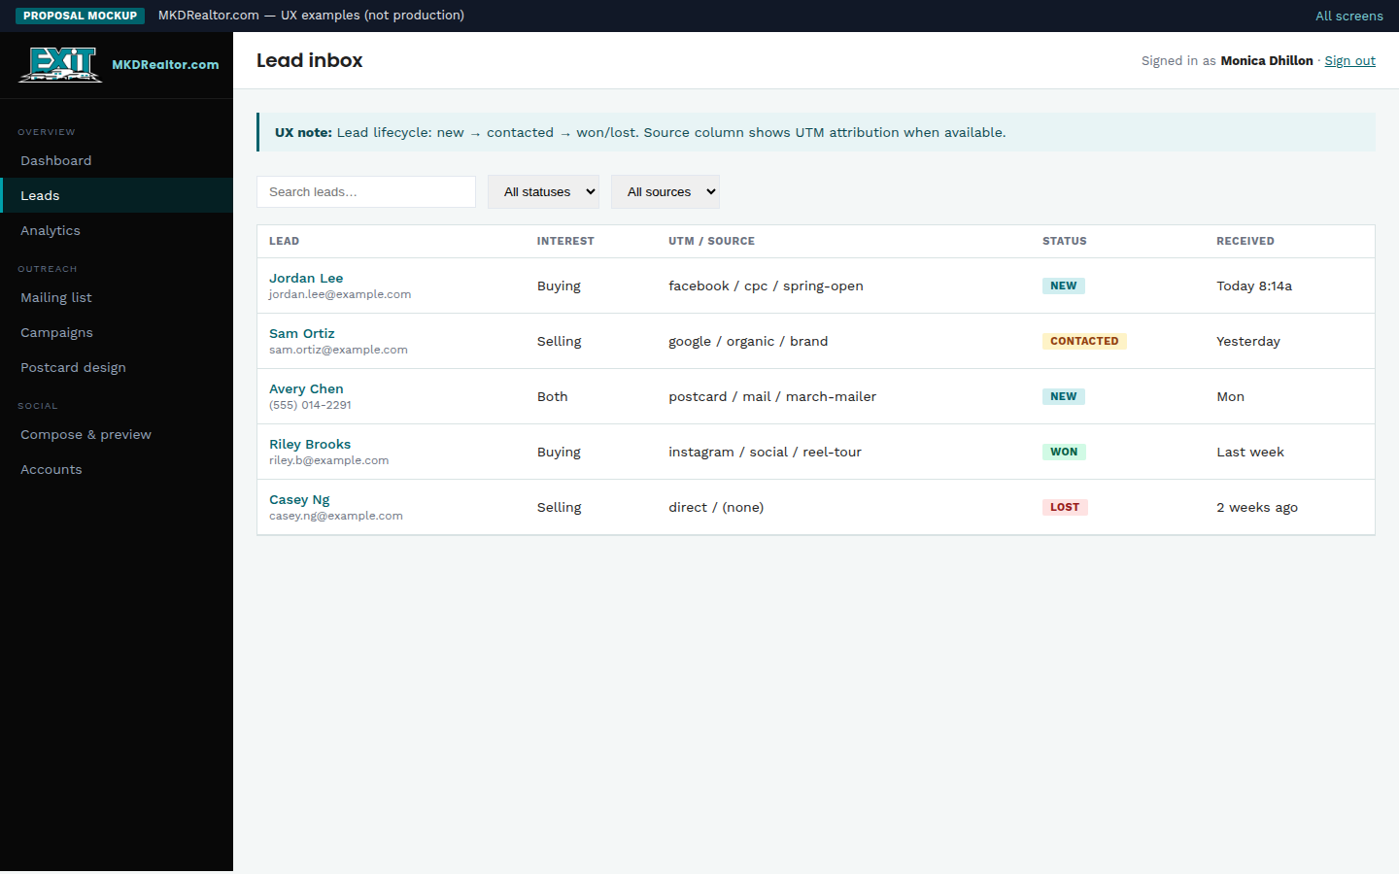
PORTAL · PHASE 1
UX mockup
Lead inbox
MKDRealtor.com · portal-leads.html · 15 / 07 / 2026

Slide 15
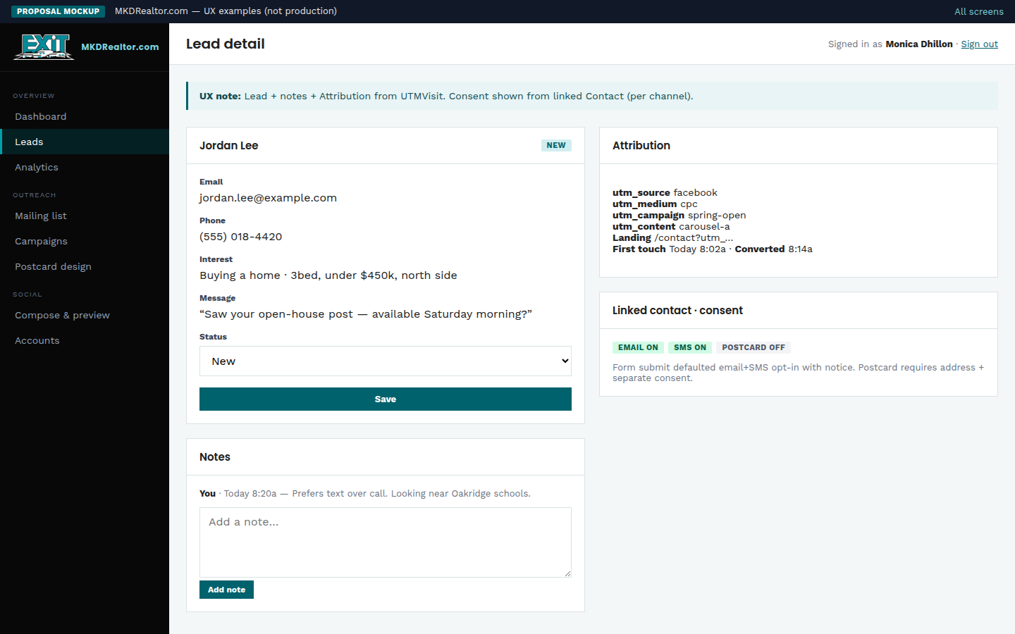
PORTAL · PHASE 1
UX mockup
Lead detail
MKDRealtor.com · portal-lead-detail.html · 15 / 07 / 2026

Slide 16
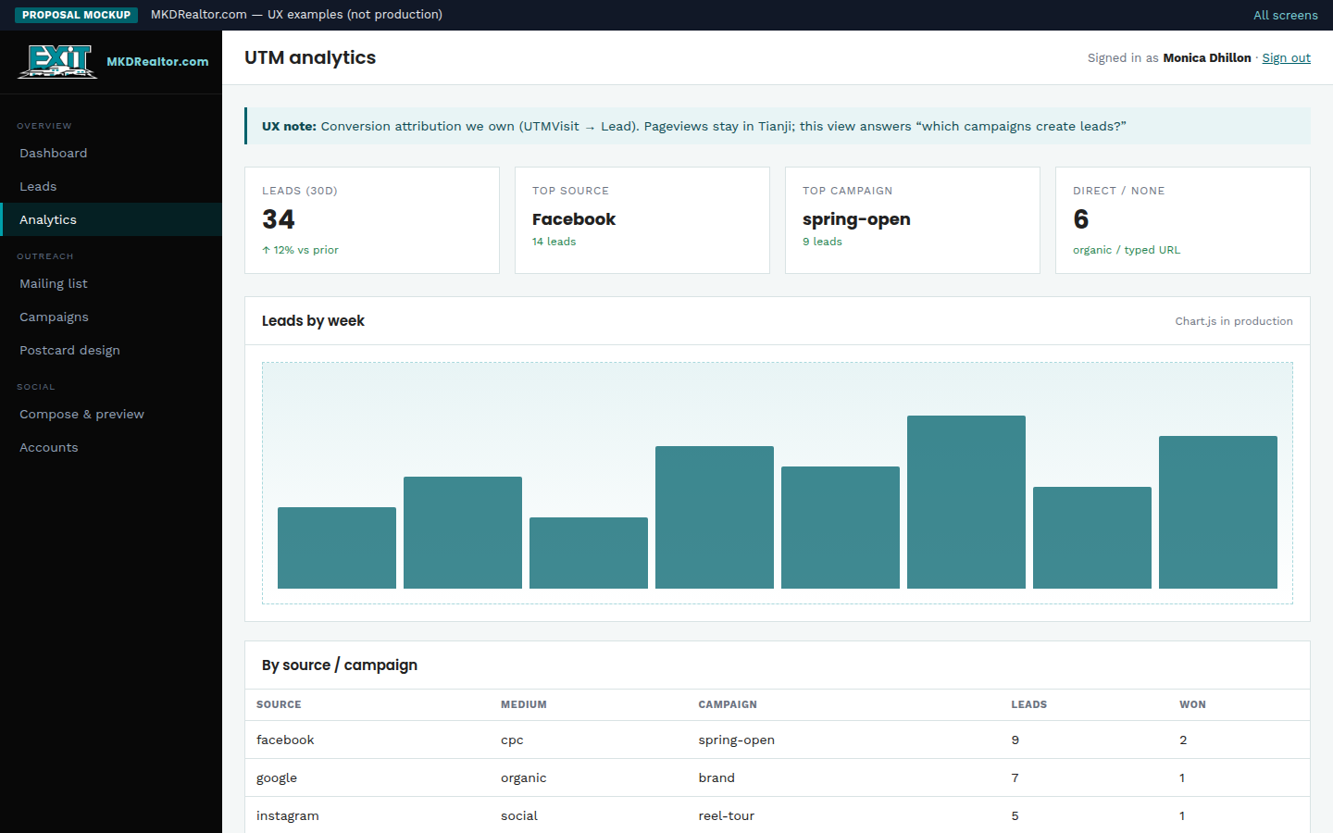
PORTAL · PHASE 1
UX mockup
UTM analytics
MKDRealtor.com · portal-analytics.html · 15 / 07 / 2026

Slide 17
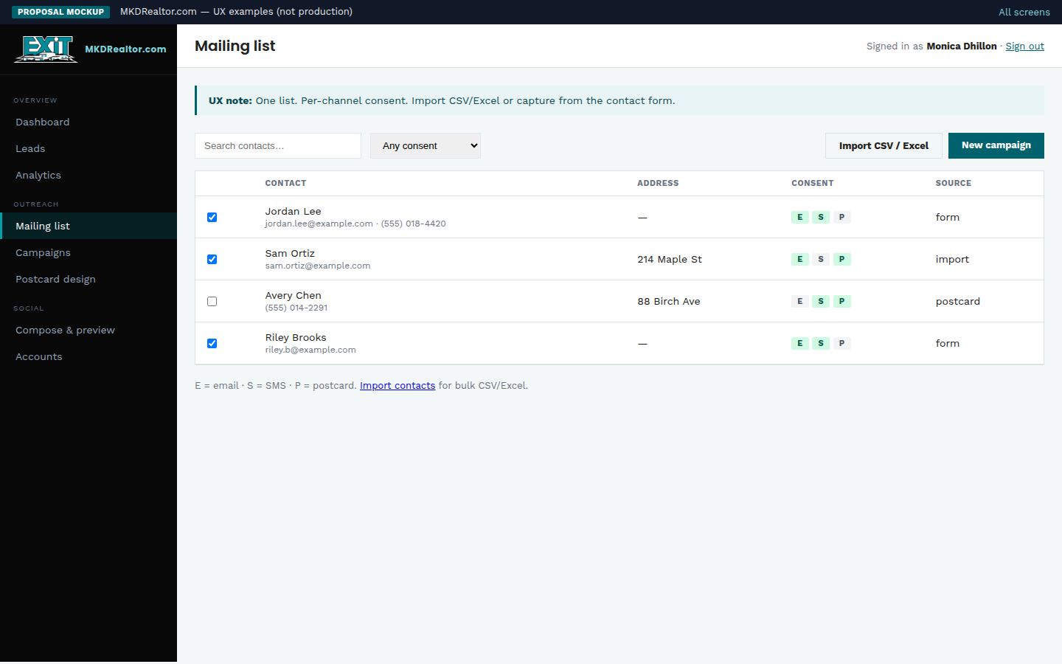
PORTAL · PHASE 2
UX mockup
Mailing list
MKDRealtor.com · portal-contacts.html · 15 / 07 / 2026

Slide 18
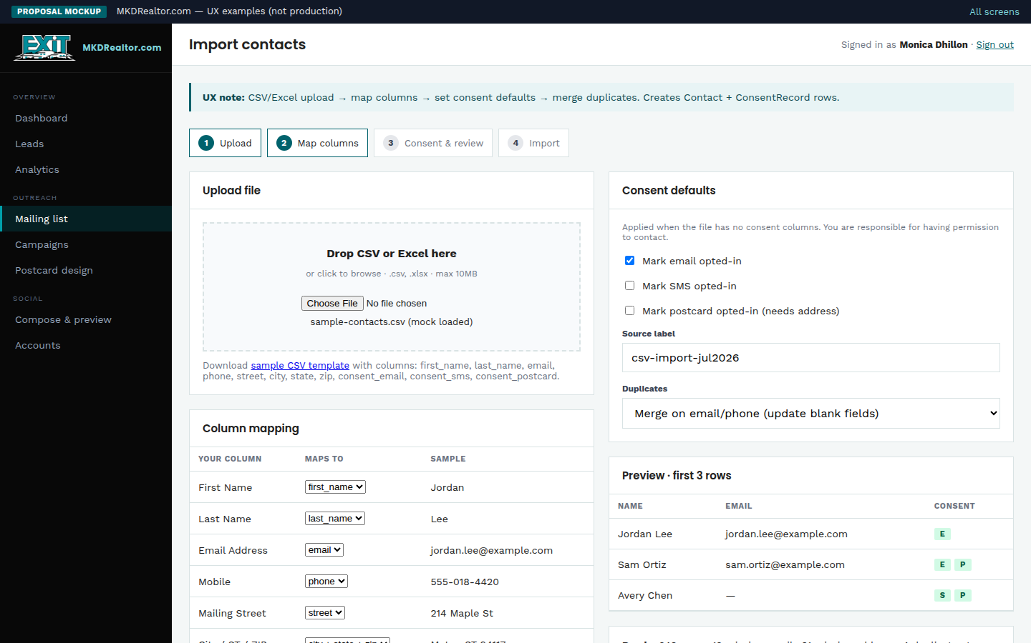
PORTAL · PHASE 2
UX mockup
Import contacts
MKDRealtor.com · portal-contacts-import.html · 15 / 07 / 2026

Slide 19
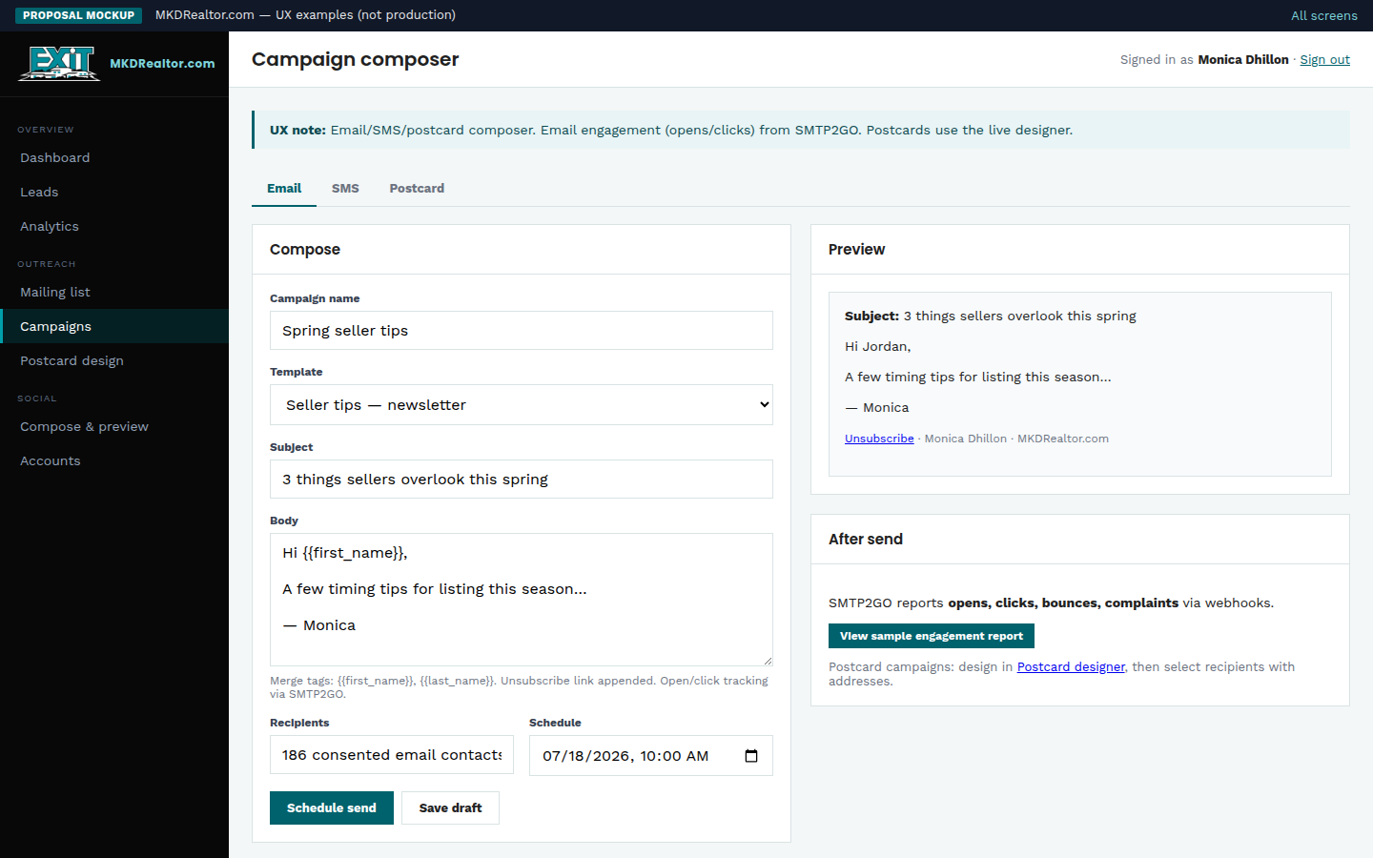
PORTAL · PHASE 2–3
UX mockup
Campaign composer
MKDRealtor.com · portal-campaign.html · 15 / 07 / 2026

Slide 20
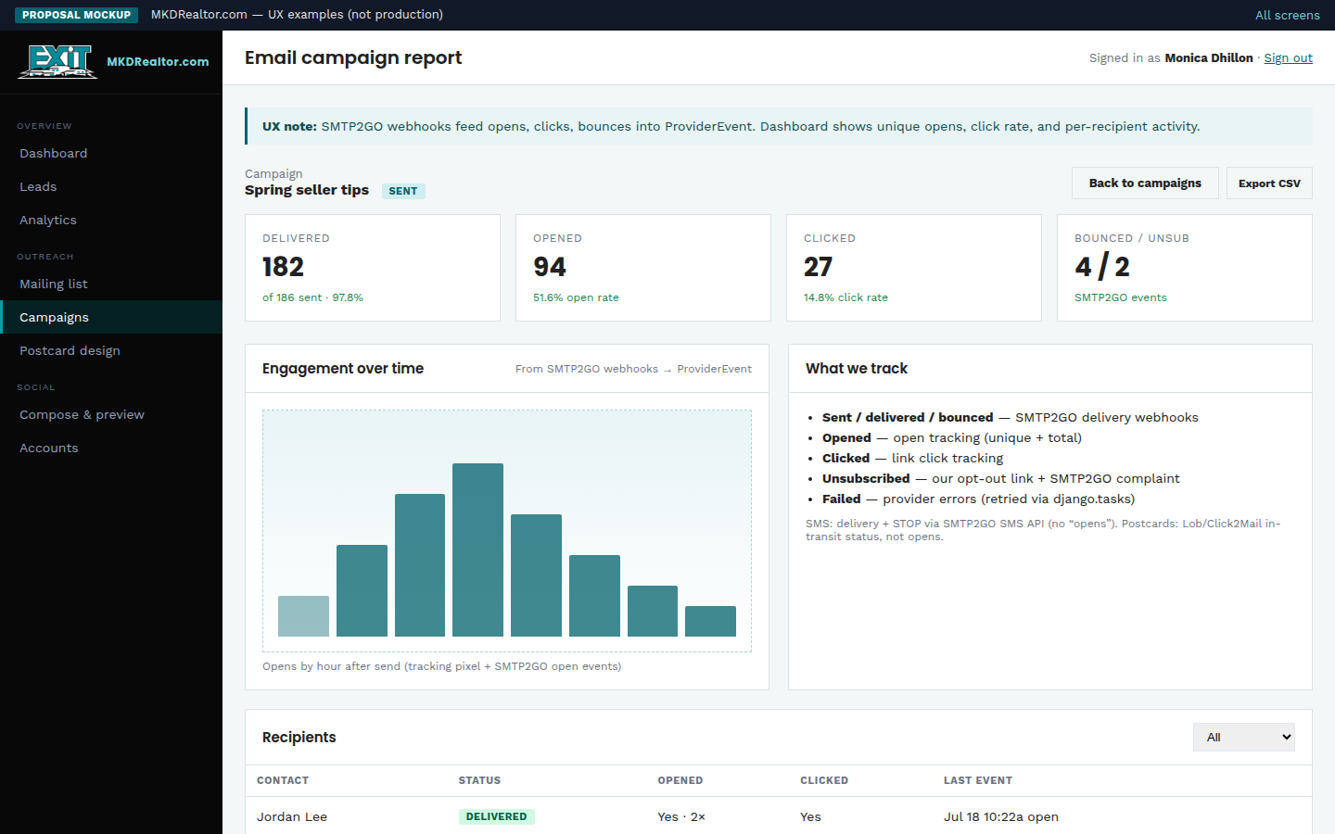
PORTAL · PHASE 2
UX mockup
Email engagement
MKDRealtor.com · portal-campaign-report.html · 15 / 07 / 2026

Slide 21
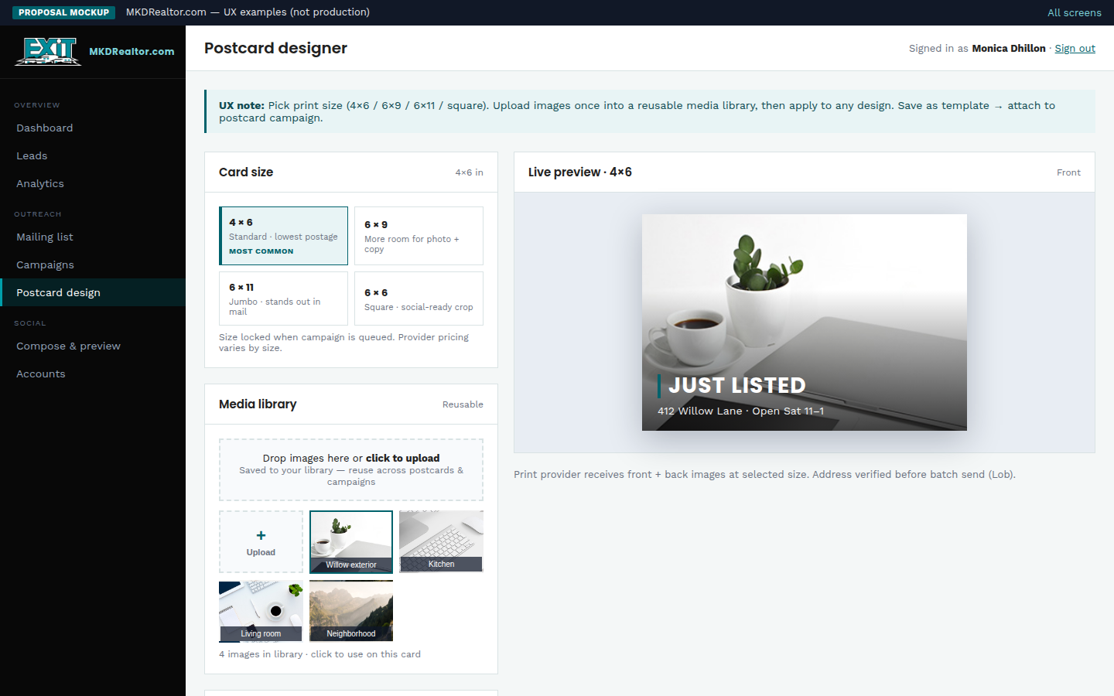
PORTAL · PHASE 3
UX mockup
Postcard designer
MKDRealtor.com · portal-postcard-designer.html · 15 / 07 / 2026

Slide 22
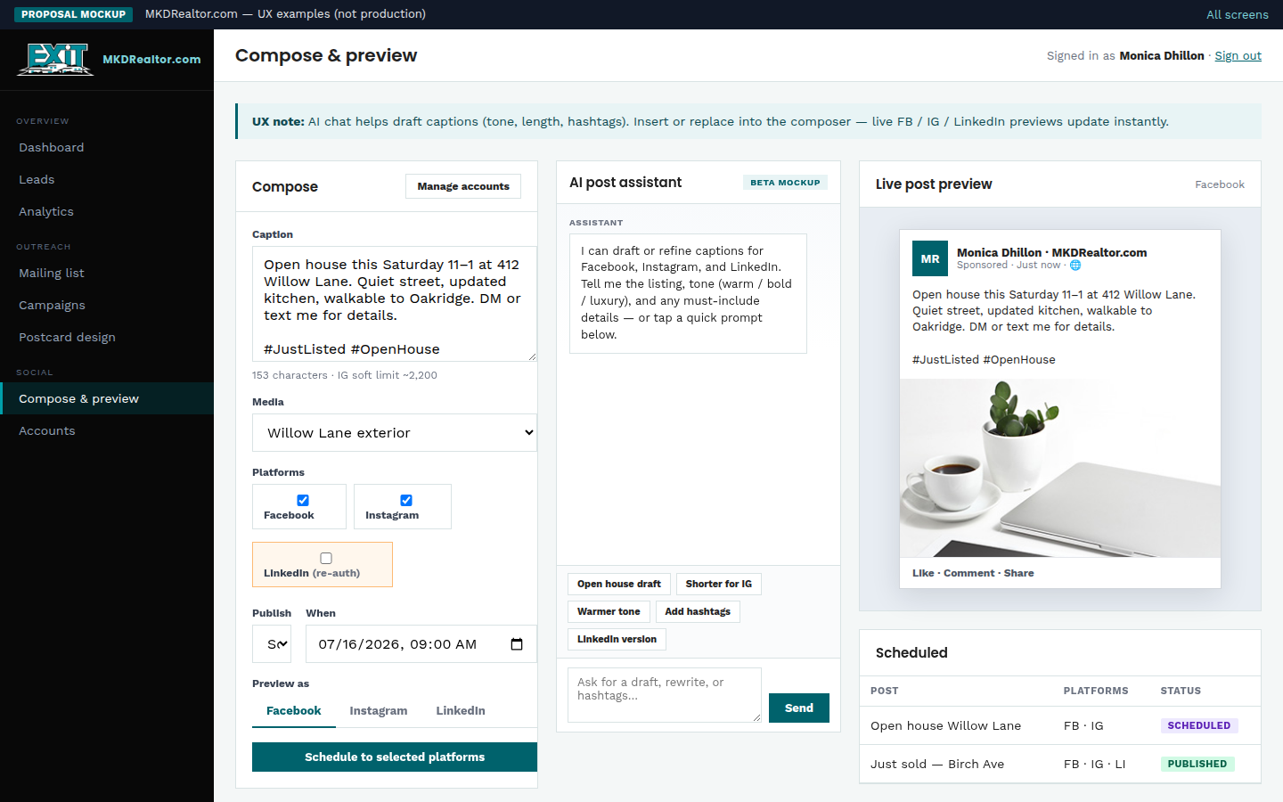
PORTAL · PHASE 4
UX mockup
Social live preview
MKDRealtor.com · portal-social.html · 15 / 07 / 2026

Slide 23
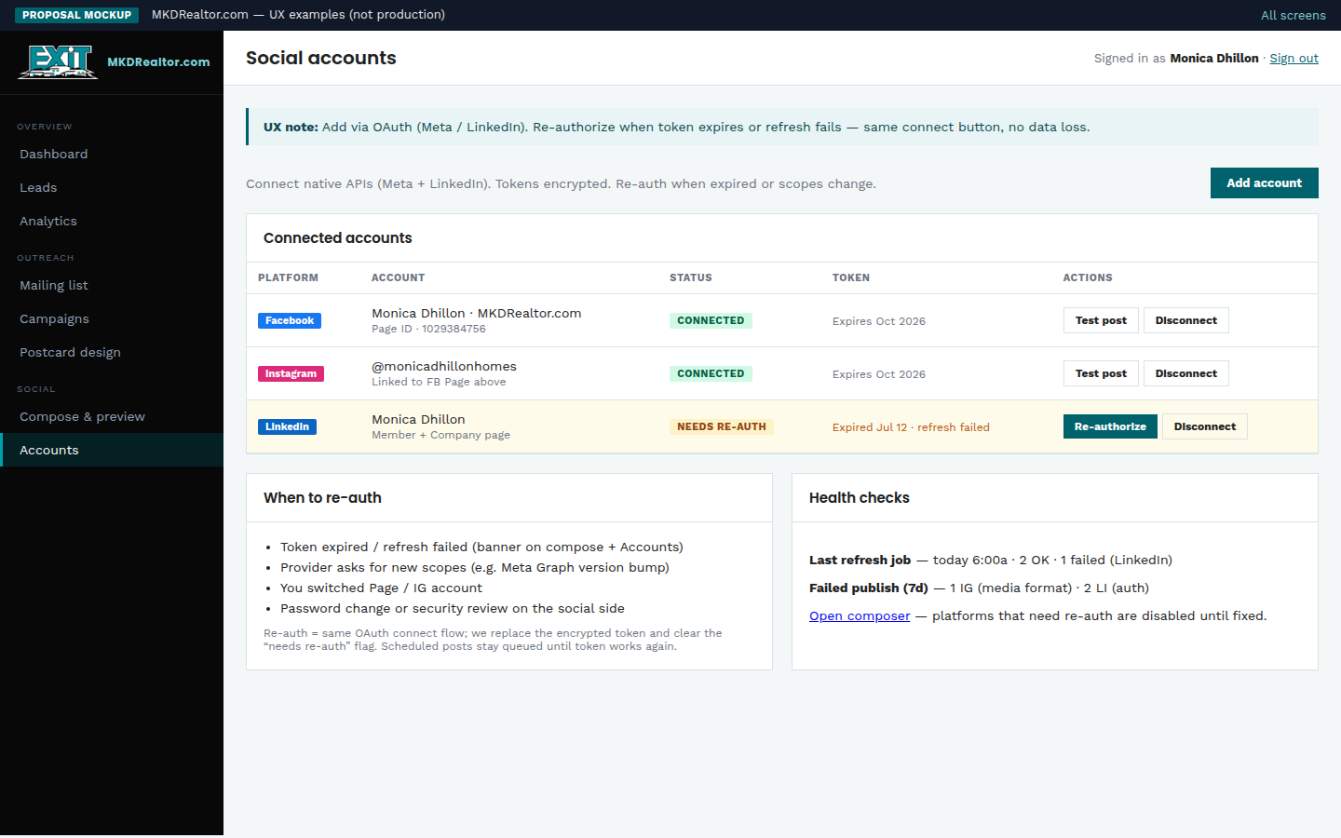
PORTAL · PHASE 4
UX mockup
Social accounts
MKDRealtor.com · portal-social-accounts.html · 15 / 07 / 2026

Slide 24
Cost
Build-out line items | Build Out Cost | Monthly Cost
Website | $1,000.00 | $0.00
Hosting | $0.00 | $200.00
Domain | $40.00* | $3.33^
Logo | $150.00 | $0.00
Email + SMS | $50.00 | $5.00
Physical Mail | $500.00 | See Table
Consolidated Social Media | $500.00 | $20.00
Total build-out | $2,240 | $228.33
*Assumed Domain Cost
^ Renewal amount divided by 12
15 / 07 / 2026

Slide 25
Physical Mailer Cost
15 / 07 / 2026

Slide 26

CONTACT US
ryan@aimloperations.com
(330) 402-2675
THANK YOU
15 / 07 / 2026

